Slide 1






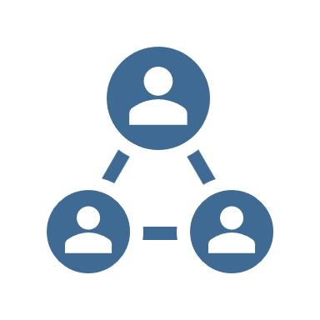
CAPABILITY ANALYSIS
Building Block | Prompts | Strengths/Weaknesses
Strategy & Performance | Research Analysis Planning KPIs Reporting Monitoring Scanning | Not so strong on research Need to do much more scanning Merit in the division and company annual planning processes Good KPIs and reporting externally but not internally Getting there with governance/monitoring
People & Knowledge | Skills Planning Oversight Sharing Transfer | High skill levels in general Succession planning is poor Skills development is excellent in pockets but needs better coordination – committed but not effective Sharing is not adequate Transfer is not adequate
Process & Systems | Programs Projects Complexity Technology Change Compliance | Generally pretty good, in particular in projects Poor at change management Compliance is improving but needs much more Better road map for technology than we had
Assets & Liabilities | Physical Intangible Balance Sheet Insurable Legal | Pretty strong re physical assets Not much by way of IP Balance sheet is very strong Insurance is robust via major insurance broker with peer review Strong on managing risk in contracts
Culture | Values Goals Leadership Stewardship Accountability Communication | High ethics/morals Strong leadership team – visible Open/transparent culture OK on accountability but could improve Try hard on communication but...
© Bryan Whitefield Consulting (While copyright remains with Bryan Whitefield Consulting, Bryan Whitefield Consulting grants permission for you to utilise this tool or template for your own internal use.).

